Slide 1

Data Structures & Algorithms
Week-11

Slide 2
Week-11 Agenda
  Linear Search
  Binary Search

Slide 3
Linear Search
Searching is the process of determining whether or not a given value exists in a data structure or a storage media.
We discuss two searching methods on one-dimensional arrays: linear search and binary search.
The linear (or sequential) search algorithm on an array is:
  Sequentially scan the array, comparing each array item with the searched value.
  If a match is found; return the index of the matched element; otherwise return –1.
Note: linear search can be applied to both sorted and unsorted arrays.

Slide 4
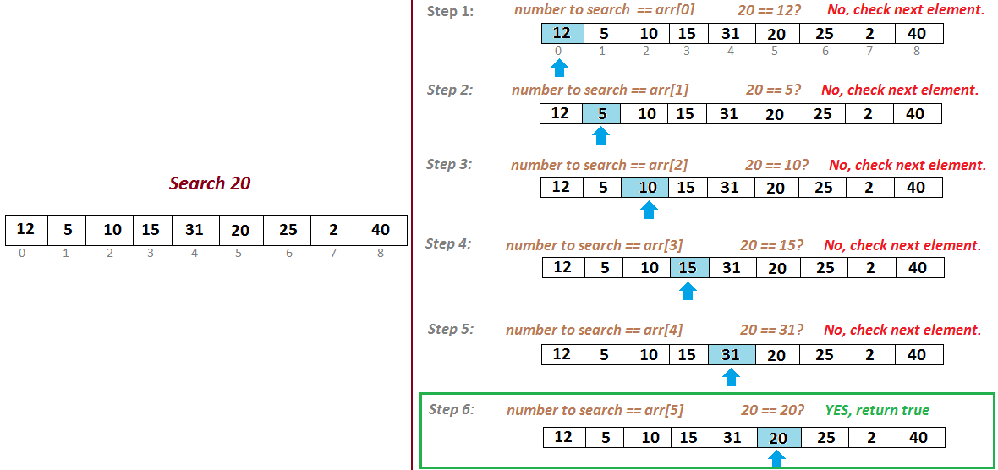
Linear Search

Slide 5
Linear Search
Bubble sort works on the repeatedly swapping of adjacent elements until they are not in the intended order.
It is called bubble sort because the movement of array elements is just like the movement of air bubbles in the water.
Bubbles in water rise up to the surface; similarly, the array elements in bubble sort move to the end in each iteration.

Slide 6
Example
Imagine that you have a database of sales made to customers. You need to deliver the goods that customer number 150 has bought, so need to find their address in the database.
The criterion is set first - Find the address for customer 150.
A linear search will begin at customer 1 and will search through each customer in turn until it reaches customer 150. It will then output the address for this customer. If it does not find customer 150, a message will be output to say that the customer is not found.

Slide 7
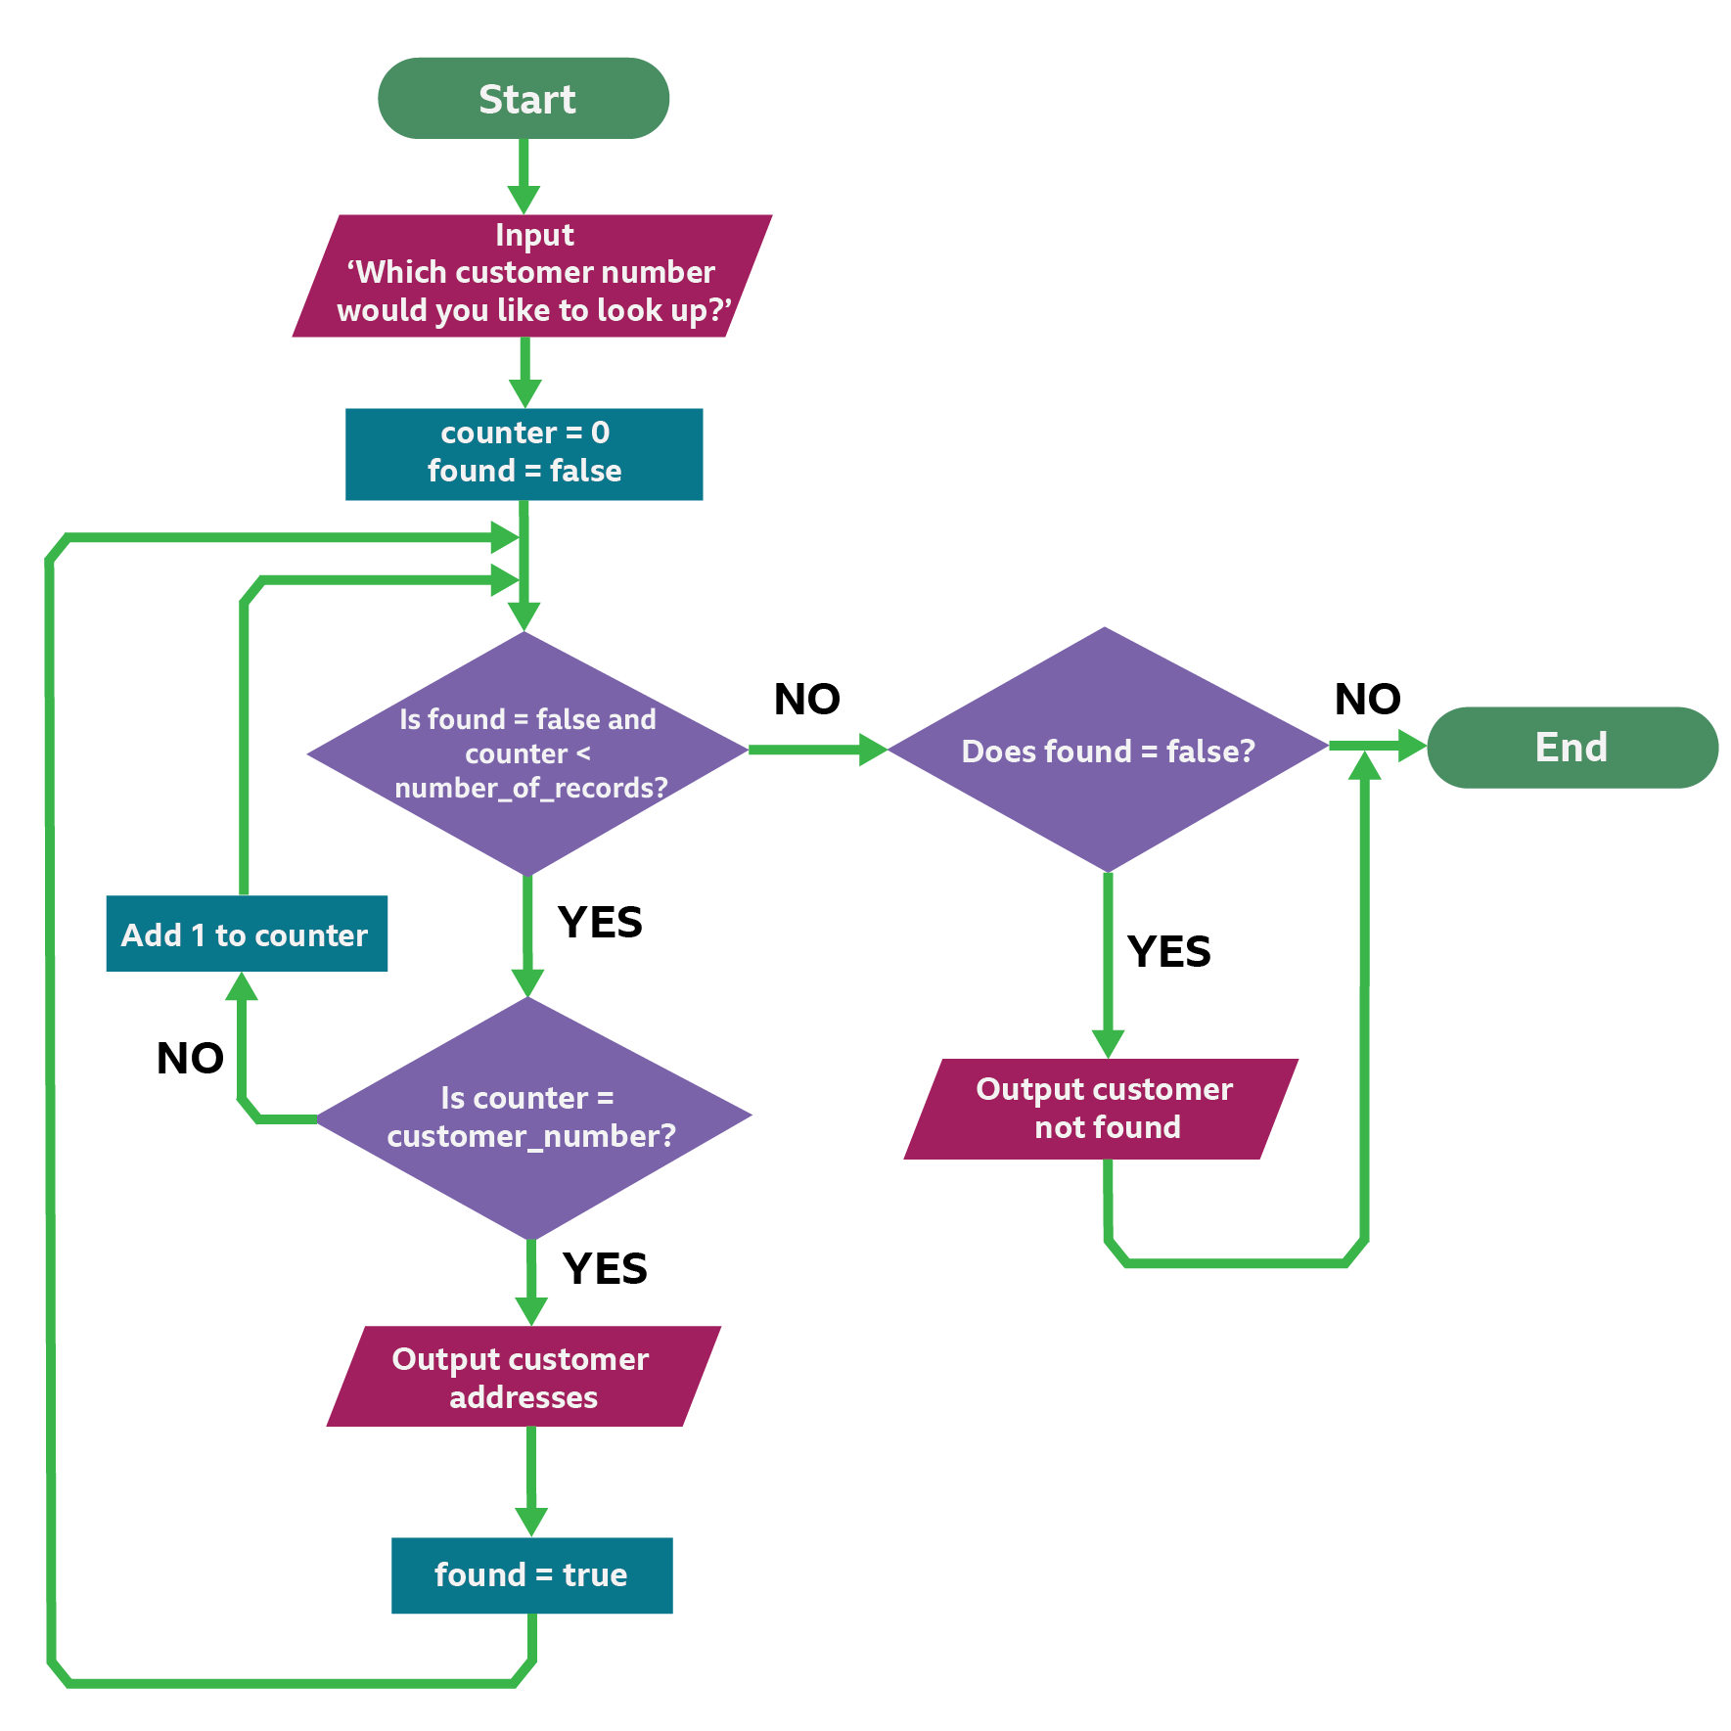
Example

Slide 8
Binary Search
Binary search: Locates a target value in a sorted array/list by successively eliminating half of the array from consideration.
  How many elements will it need to examine? O(log N)
  Can be implemented with a loop or recursively
  Example: Searching the array below for the value 42:
index | 0 | 1 | 2 | 3 | 4 | 5 | 6 | 7 | 8 | 9 | 10 | 11 | 12 | 13 | 14 | 15 | 16
value | -4 | 2 | 7 | 10 | 15 | 20 | 22 | 25 | 30 | 36 | 42 | 50 | 56 | 68 | 85 | 92 | 103
min
mid
max

Slide 9
Binary Search
Here’s how the binary search algorithm works:
  Check if nums[mid] is equal to the target. If so, we’ve already found a match—in the very first step—and the search terminates.
  If nums[mid] > target, you only need to search the left half of the array. Even when you search through the left subarray you can use the same binary search algorithm.
  If nums[mid] < target, you can ignore all the elements up to the middle element and only consider the right half of the array.

Slide 10
Binary Search
Here’s how the binary search algorithm works:
  Check if nums[mid] is equal to the target. If so, we’ve already found a match—in the very first step—and the search terminates.
  If nums[mid] > target, you only need to search the left half of the array. Even when you search through the left subarray you can use the same binary search algorithm.
  If nums[mid] < target, you can ignore all the elements up to the middle element and only consider the right half of the array.

Slide 11
Binary Search
The binary search algorithm uses the divide-and-conquer approach; it does not scan every element in the list; it only searches half of the list instead of going through each element.
It is said to be the best searching algorithm because it is faster to execute than linear search.

Slide 12
Binary Search
Binary search. Given value and sorted array a[], find index i
such that a[i] = value, or report that no such index exists.
Invariant. Algorithm maintains a[lo] ≤ value ≤ a[hi].
Ex. Binary search for 33.
6
13
14
25
33
43
51
53
64
72
84
93
95
96
97
0
1
2
3
4
5
6
7
8
9
10
11
12
13
14
lo
hi

Slide 13
Binary Search
Binary search. Given value and sorted array a[], find index i
such that a[i] = value, or report that no such index exists.
Invariant. Algorithm maintains a[lo] ≤ value ≤ a[hi].
Ex. Binary search for 33.
6
13
14
25
33
43
51
53
64
72
84
93
95
96
97
0
1
2
3
4
5
6
7
8
9
10
11
12
13
14
lo
mid
hi

Slide 14
Binary Search
Binary search. Given value and sorted array a[], find index i
such that a[i] = value, or report that no such index exists.
Invariant. Algorithm maintains a[lo] ≤ value ≤ a[hi].
Ex. Binary search for 33.
6
13
14
25
33
43
51
53
64
72
84
93
95
96
97
0
1
2
3
4
5
6
7
8
9
10
11
12
13
14
lo
hi

Slide 15
Binary Search
Binary search. Given value and sorted array a[], find index i
such that a[i] = value, or report that no such index exists.
Invariant. Algorithm maintains a[lo] ≤ value ≤ a[hi].
Ex. Binary search for 33.
6
13
14
25
33
43
51
53
64
72
84
93
95
96
97
0
1
2
3
4
5
6
7
8
9
10
11
12
13
14
lo
mid
hi

Slide 16
Binary Search
Binary search. Given value and sorted array a[], find index i
such that a[i] = value, or report that no such index exists.
Invariant. Algorithm maintains a[lo] ≤ value ≤ a[hi].
Ex. Binary search for 33.
6
13
14
25
33
43
51
53
64
72
84
93
95
96
97
0
1
2
3
4
5
6
7
8
9
10
11
12
13
14
lo
hi

Slide 17
Binary Search
Binary search. Given value and sorted array a[], find index i
such that a[i] = value, or report that no such index exists.
Invariant. Algorithm maintains a[lo] ≤ value ≤ a[hi].
Ex. Binary search for 33.
6
13
14
25
33
43
51
53
64
72
84
93
95
96
97
0
1
2
3
4
5
6
7
8
9
10
11
12
13
14
lo
mid
hi

Slide 18
Binary Search
Binary search. Given value and sorted array a[], find index i
such that a[i] = value, or report that no such index exists.
Invariant. Algorithm maintains a[lo] ≤ value ≤ a[hi].
Ex. Binary search for 33.
6
13
14
25
33
43
51
53
64
72
84
93
95
96
97
0
1
2
3
4
5
6
7
8
9
10
11
12
13
14
lo
hi

Slide 19
Binary Search
Binary search. Given value and sorted array a[], find index i
such that a[i] = value, or report that no such index exists.
Invariant. Algorithm maintains a[lo] ≤ value ≤ a[hi].
Ex. Binary search for 33.
6
13
14
25
33
43
51
53
64
72
84
93
95
96
97
0
1
2
3
4
5
6
7
8
9
10
11
12
13
14
lo
hi
mid

Slide 20
Binary Search
Binary search. Given value and sorted array a[], find index i
such that a[i] = value, or report that no such index exists.
Invariant. Algorithm maintains a[lo] ≤ value ≤ a[hi].
Ex. Binary search for 33.
6
13
14
25
33
43
51
53
64
72
84
93
95
96
97
0
1
2
3
4
5
6
7
8
9
10
11
12
13
14
lo
hi
mid

Slide 21
Example
Imagine that you have a database of customers and want to search for the customer "John Smith". Before performing a binary search, the database must be sorted alphabetically by surname. You can then search for the record "John Smith" using the surname.
The binary search starts at the midpoint of the list and compares the middle record with "John Smith". If the midpoint record surname matches "John Smith", the search ends.
If not, the search continues:
If the midpoint record comes alphabetically before "John Smith", the first half of the list is discarded, including the midpoint record.
If the midpoint record comes after "John Smith", the second half of the list is discarded, starting from the midpoint.
The search then repeats this process with the remaining records, finding the new midpoint each time. The search ends when either a match is found or there are no more records left to search through.

Slide 22
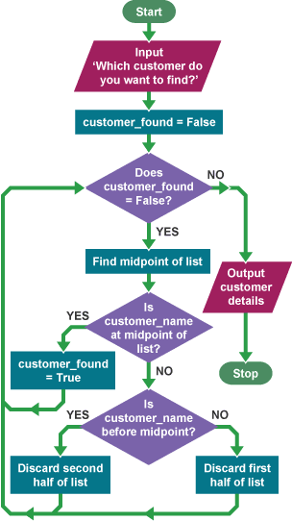
Example

Slide 23
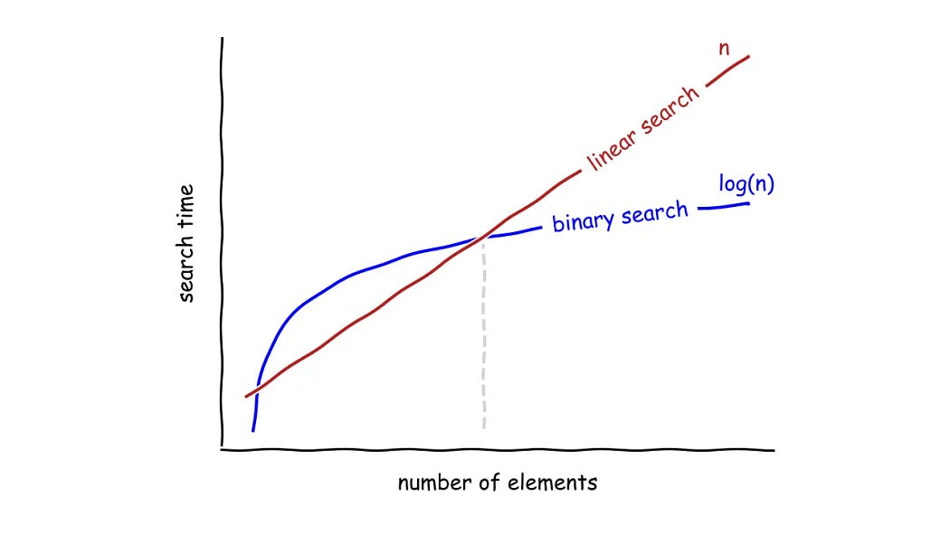
Time and Space Complexity

Slide 24
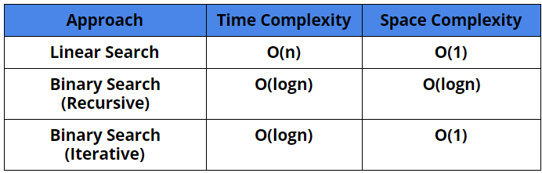
Time and Space Complexity

Slide 25


